Slide 1
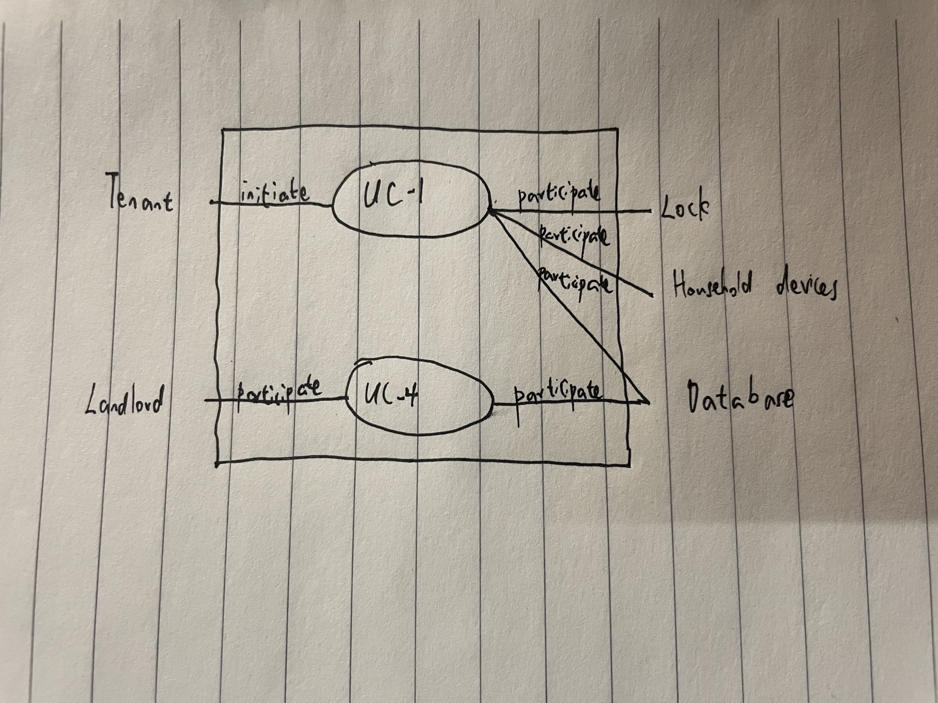

Slide 2
Use Case 1: Unlock
Use Case UC-1: |  |  | Unlock
Related Requirem’ts: |  |  | REQ2, REQ3, REQ7, and REQ9
Initiating Actor: |  |  | Any of: Tenant, Landlord
Actor’s Goal: |  |  | To disarm the lock and enter
Participating Actors: |  |  | Lock, Household Devices, Database
Preconditions: |  |  | • The set of valid keys stored in the system database is non-empty. • The system displays the menu of available functions; at the door keypad the menu choices are “Lock” and “Unlock.”
Postconditions: |  |  | The auto-lock timer has started countdown from autoLockInterval.
Flow of Events for Main Success Scenario:
→ | 1. | Tenant/Landlord arrives at the door and selects the menu item “Unlock”
 | 2. | include::AuthenticateUser (UC-7)
← | 3. | System (a) signals to the Tenant/Landlord the lock status, e.g., “disarmed,” (b) signals to LockDevice to disarm the lock
← | 4. | System signals to the Timer to start the auto-lock timer countdown
→ | 5. | Tenant/Landlord opens the door, enters the home [and shuts the door and locks]

Slide 3
Use Case 1: Unlock
Use Case UC-4: |  |  | RetireUser
Related Requirem’ts: |  |  | REQ7
Initiating Actor: |  |  | Any of: Landlord
Actor’s Goal: |  |  | Retire an existing user account and disable access.
Participating Actors: |  |  | Database
Preconditions: |  |  | The database stores the accounts that allowed to unlock
Postconditions: |  |  | The removed accounts cannot unlock.
Flow of Events for Main Success Scenario:
→ | 1. | Tenant/Landlord arrives at the door and selects the menu item “Unlock”
 | 2. | include::AuthenticateUser (UC-7)
← | 3. | System (a) signals to the Tenant/Landlord the lock status, e.g., “disarmed,” (b) signals to LockDevice to disarm the lock
← | 4. | System signals to the Timer to start the auto-lock timer countdown
→ | 5. | Tenant/Landlord opens the door, enters the home [and shuts the door and locks]

Slide 4
Acceptance Test Case for UC-7 Authenticate User
Test-case Identifier: | TC-1
Use Case Tested: | UC-1, main success scenario, and UC-7
Pass/fail Criteria: | The test passes if the user uses valid mobile phone that is contained in the database, with less than a maximum allowed number of unsuccessful attempts
Input Data: | valid mobile phone
Test Procedure: |  | Expected Result:
Step 1. use invalid mobile phone |  | System beeps to indicate failure; records unsuccessful attempt in the database; prompts the user to try again
Step 2. use valid mobile phone |  | System flashes a green light to indicate success; records successful access in the database; disarms the lock device

Slide 5
Acceptance Test Case for UC-7 Authenticate User
Test-case Identifier: | TC-4
Use Case Tested: | UC-4, main success scenario
Pass/fail Criteria: | The test passes if the user uses valid mobile phone that is contained in the database
Input Data: | existing user account
Test Procedure: |  | Expected Result:
Step 1. retire a non-existent account |  | System emits an error beep indicating that the account does not exist.
Step 2. retire an existent account |  | System asks for confirmation to delete the account and upon receiving a second confirmation

